Slide 1



WEBINAR
Employment Law
October Changes
The biggest package of the Employment Rights Act 2025.
What changes on 1 and 30 October, and what to do now.
Delivered by Ashmina Raghwani | Associate Solicitor, Thrive Law
and Bryony Curtis | Associate Solicitor, Thrive Law
02 September 2026 | 1:00pm to 1:45pm
thrivelaw.co.uk | enquiries@thrivelaw.co.uk | 0113 869 8101
Notes:
Ash (introduce Bryony as it’s her first webinar instead of Liss)
Welcome everyone, and thank you for joining us. I am Bryony, and I am joined by my colleague Ashmina Raghwani, Associate Solicitor here at Thrive Law.
Today is about one thing: getting you ready for October. The Employment Rights Act 2025 has been landing in phases since December 2025, and this autumn brings the biggest package so far. Two dates matter. On 1 October the tribunal clock doubles. On 30 October the harassment duty steps up and a whole set of trade union rights come into force.
We have about 45 minutes. There will be a few Slido polls along the way, time for questions at the end, and a practical action plan to close. Everything we cover today reflects the government roadmap as updated on 16 July 2026, plus the regulations and codes of practice published since.
One housekeeping point before we start: this is general information, not legal advice on your specific situation. If something we say today makes you think about a particular case, please do come and talk to us afterwards.

Slide 2
Two Dates,
One Autumn
On 1 October the time limit for most tribunal claims doubles. On 30 October the duty to prevent harassment steps up and trade unions get a statutory right into your workplace. Here is what changes, and what you need to have done before then.
thrivelaw.co.uk | enquiries@thrivelaw.co.uk | 0113 869 8101
Notes:
Ashmina
Before we get started, let me just set the scene.
There’s been a lot of noise around the Employment Rights Act, and understandably, there’s probably some fatigue around it. The Act received Royal Assent in December 2025 and is being brought in over roughly two years. Some of the changes have already happened, while others are still being consulted on. The risk is that people start to tune out, and then miss the changes that actually come into force.
So today, we’re going to be deliberately narrow. We’re focusing on what is confirmed and dated, in particular, the changes taking effect on 1 and 30 October 2026, together with the pieces immediately either side of those dates.
We’ll also look briefly ahead to January 2027, when the unfair dismissal changes come in, so that you have a running start on those.
The key thing to remember is that the Act is arriving in phases, not all at once. October 2026 has some of the biggest changes coming into effect, and everything we’re covering today has a confirmed commencement date, subject to the usual parliamentary processes. There is still some detail coming through in secondary legislation and codes of practice, so we’ll flag that where relevant as we go.

Slide 3
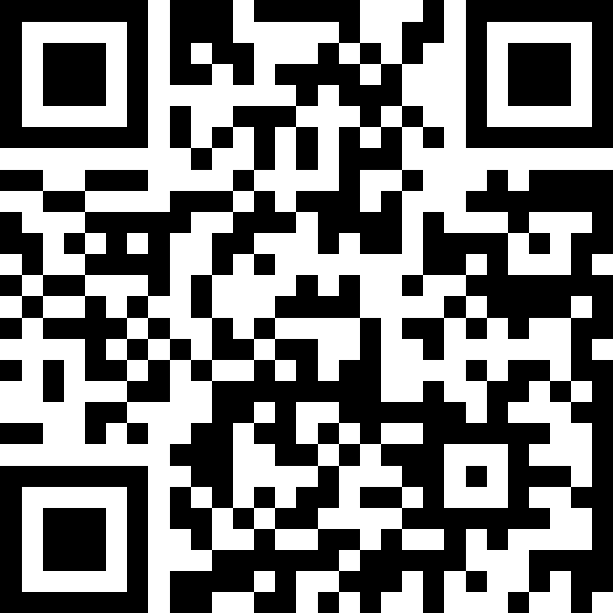
Do not edit
How to change the design
Join at slido.com
#3722676
The Slido app must be installed on every computer you’re presenting from
Notes:
Bryony
Before we get into the substance, we are going to use Slido for a quick poll. The joining details are on screen. It is completely anonymous, so please be honest.
Please do join now if you can.

Slide 4
Do not edit
How to change the design
Do you feel ready for more employment law changes?
The Slido app must be installed on every computer you’re presenting from
Notes:
Bryony
As you’ll all probably know, there has been a LOT of change recently given the Employment Rights Act 2025. So our question is, at this point in time, do you feel ready for more employment law changes? Or does the future feel a little but fuzzy still?
The options are:
I'm confident and ready for the changes
I know most of what I need to
I know some information
I don’t know what to expect
So give your opinion now - I’ll give everyone a few seconds….
….REACT
[if lots of not sure – don’t worry, this session is aimed at giving the key points so you should have a clear plan by the end]

Slide 5


THE ROADMAP
Where we are, and what is coming
Already in force
1 October 2026
Sick pay reform, day one paternity and parental leave, whistleblowing, Fair Work Agency
Time limit for most tribunal claims rises from three months to six.
30 October 2026
January 2027
December 2026
All reasonable steps on sexual harassment, third party liability, and trade union reforms.
Unfair dismissal qualifying service period falls to six months, compensation becomes uncapped.
thrivelaw.co.uk | enquiries@thrivelaw.co.uk | 0113 869 8101
Notes:
Bryony
This is the map for the rest of the session. It is worth spending a moment on it because the phasing is genuinely confusing and people lose track.
Working left to right. The top row is history: February and April 2026 brought statutory sick pay reform, removing the lower earnings limit and the waiting period, day one paternity and unpaid parental leave, explicit whistleblowing protection for people who raise sexual harassment, a doubled maximum protective award for collective redundancy failures, and the establishment of the Fair Work Agency on 7 April. April also relaxed the union recognition thresholds.
By 31 August, electronic and workplace balloting arrives for statutory union ballots. That one is narrow but it matters, because postal ballots have been a real practical brake on industrial action and that brake is coming off.
Then the two big October dates, which are the heart of today.
December brings the seafarers regulations and, importantly for anyone in hospitality, the strengthened tipping rules. Those were originally pencilled in for October and have moved to the end of the year.
And then January 2027, which is where unfair dismissal changes.
Key Points
The Act is phased across 2026 and 2027, and the government updated the roadmap on 16 July 2026.
Nine or so measures already took effect in February and April 2026.
Two October dates: 1 October for tribunal time limits, 30 October for harassment and trade unions.
Tipping moved from October to the end of 2026.
All future dates remain subject to parliamentary processes.
Worth flagging: the great majority of the Act does not apply in Northern Ireland, where employment law is devolved.

Slide 6

FIRST OF THE TWO DATES
1 OCT
The Tribunal clock doubles
For most claims, employees will have six months rather than three. It sounds procedural. It is not. It changes how long your decisions stay exposed and how good your records need to be.
thrivelaw.co.uk | enquiries@thrivelaw.co.uk | 0113 869 8101
Notes:
Ashmina
Right, first of our two dates. 1 October 2026.
This is the change that I think will have the widest practical effect, because it touches every employer regardless of sector, size or whether you have ever seen a union in your building.
The time limit for bringing most employment tribunal claims doubles from three months to six.
I want to be clear about why this matters more than it sounds. A limitation period is not just an administrative detail. It is the point at which you can close the file. Push that out by three months and you change how long you keep documents, how long you need people to remember conversations, and how long a difficult exit stays live on your risk register.
Let us look at the detail.

Slide 7

1 OCTOBER 2026
Three months becomes six
Covers unfair dismissal, discrimination, whistleblowing, TUPE, unlawful deductions and working time
The new limit applies where the act complained of falls on or after 1 October 2026
For a series of acts, what matters is the date of the last act in that series
For breach of contract claims, time usually runs from the effective date of termination
Events entirely before 1 October keep the existing three month limit
TIME LIMIT
3 to 6
months, less one day, for most tribunal claims
thrivelaw.co.uk | enquiries@thrivelaw.co.uk | 0113 869 8101
Notes:
Ashmina
Here is where the detail really matters, because we’re heading into a period of overlap.
From 1 October 2026, the time limit for most Employment Tribunal claims increases to six months less one day. That covers the claims we see most often i.e. unfair dismissal, discrimination claims, whistleblowing detriment and dismissal, TUPE, unlawful deductions from wages and working time breaches.
The six-month limit only applies where that event occurs on or after 1 October 2026. If everything happened before 1 October, the old three-month limit still applies.
Where you have a series of acts i.e. an unlawful deductions from wages being the classic example, you look at the last act in the series. So if a series starts in September but continues into October, the longer time limit will apply.
For breach of contract claims, the relevant date is usually the effective date of termination. There is a slightly later change in Scotland, where breach of contract claims arising on termination follow from 9 November 2026.
So, practically, through late 2026 and into 2027, you can’t simply work out the deadline from the date the claim form arrives. You need to go back to the date of the underlying event. We’re likely to see mistakes made on both sides of that transition.
So the headline is: six months less one day for acts on or after 1 October; for a series of acts, look at the last act; for contract claims, usually the effective date of termination; and for anything before October, the old three-month limit still applies. And importantly, the Tribunal’s existing discretion to allow late claims has not changed.

Slide 8

1 OCTOBER 2026
Think longer than six months
Acas Early Conciliation is still mandatory before a claim can be issued, and it still pauses the limitation clock
The conciliation window itself rose from six to twelve weeks, for notifications from 1 December 2025
Stack the two together and the outer edge for some claims moves towards nine months
Tribunals keep their existing discretion to extend time where the statutory test is met
A dismissal in early October 2026 could realistically produce a claim form the following summer
The government has said it will review whether the twelve week conciliation period should stay
thrivelaw.co.uk | enquiries@thrivelaw.co.uk | 0113 869 8101
Notes:
Ashmina
This is probably the slide I’d most like you to take away, because six months isn’t really the number.
Early Conciliation itself hasn’t changed. A claimant still has to notify ACAS before issuing a claim, and the clock stops while conciliation is running. What has changed, separately, is the length of the conciliation window. For notifications made on or after 1 December 2025, that went from six weeks to twelve weeks.
So put those two things together. You have six months, potentially up to twelve weeks where the clock is stopped for conciliation, and then the Tribunal’s existing discretion to extend time where it is just and equitable, or where it was not reasonably practicable to bring the claim in time. In practical terms, for some claims, that means the realistic outer edge is moving towards nine months from the original event.
Think about what that means in human terms. If you dismiss someone in the first week of October 2026, under the old regime you might have expected the issue to be resolved by around mid-January. Under the new regime, a claim could still land the following summer. By then, the manager who made the decision may have left, the investigating officer may have dealt with another twenty cases, and nobody may remember exactly what was said in the corridor.
And that is the real risk here. It’s not just a legal risk, it’s an evidence risk.
So the key message is: don’t hear “six months” and assume you have six months. Early Conciliation remains mandatory, the conciliation period is now up to twelve weeks, and that time doesn’t count towards the limitation period. The Tribunal’s discretion to extend time is also unchanged. So, for some claims, you could be looking at a window approaching nine months. And one final point: that twelve-week conciliation period is itself under review.

Slide 9

WHAT TO DO
Six practical responses
Extend retention
Write it down now
Name your witnesses
Contemporaneous notes beat recollection. Make managers write decisions up on the day.
Breathe a sigh of relief if you haven’t heard anything after a total of 9 months.
Records you would have destroyed at six months may be the evidence you need at twelve.
Identify decision makers and likely witnesses early, and capture their account while fresh.
Resolve early
Brief your managers
Check the event date
A longer window makes prompt, well documented resolution more valuable, not less.
Decisions taken from October carry a longer tail. Managers need to know that.
In the overlap period, the deadline runs from the date of the act, not the claim form.
thrivelaw.co.uk | enquiries@thrivelaw.co.uk | 0113 869 8101
Notes:
Ashmina
So, what do you actually do about it? There are six things.
First, retention. Go and look at your data retention schedule. A lot of schedules were written when three months, plus a short conciliation window, was the relevant horizon. If you’re deleting investigation notes, interview records or performance documentation at six or nine months, you could be destroying your own defence. Obviously, that needs to be balanced against your data protection obligations, but the important thing is to review it deliberately rather than letting it happen by accident.
Second, contemporaneous notes. This isn’t new advice, but it matters much more now. A note written on the day can carry real weight with a Tribunal. A statement reconstructed nine months later is much less reliable.
Third, when something does go wrong, identify your decision-makers and witnesses early, and take an account while the memories are fresh. People leave, and that is probably the single biggest evidential problem created by the longer limitation period.
Fourth, early resolution. Handle grievances and disciplinary processes promptly and properly. A well-run process that resolves the issue is now worth even more than it was before.
Fifth, brief your managers. They need to understand that a decision they make in November could still be live the following August. This is not something that just disappears after a few months.
And sixth, this is the technical one for the HR team, during the overlap period, always check the date of the underlying event before you assume which deadline applies. The question is not when the claim form arrives; it’s when the act, detriment or infringement happened

Slide 10

SECOND OF THE TWO DATES
30 OCT
The harassment bar rises
Reasonable steps becomes all reasonable steps, and employers become liable for harassment of their staff by customers, clients, contractors and visitors.
thrivelaw.co.uk | enquiries@thrivelaw.co.uk | 0113 869 8101
Notes:
Bryony
Our second date, and for a lot of you this will be the one that generates the most work.
30 October 2026 brings two harassment changes. The existing duty to prevent sexual harassment gets stronger, and a new liability arrives for harassment by third parties.
If you have any staff who deal with the public, customers, clients, patients or contractors, this slide is the one to pay attention to. Retail, hospitality, healthcare, transport, construction, facilities management, education, professional services with client facing teams. Which is most of us.
Let us take them one at a time.

Slide 11

30 OCTOBER 2026
From reasonable steps to all reasonable steps
Since 26 October 2024, section 40A of the Equality Act has required employers to take reasonable steps to prevent sexual harassment
From 30 October 2026, that becomes a duty to take all reasonable steps
The test shifts to whether there was anything further you could reasonably have done
It is an anticipatory duty: you are expected to act before a complaint, not react after one
thrivelaw.co.uk | enquiries@thrivelaw.co.uk | 0113 869 8101
Notes:
Bryony
Start with where we are today. Since 26 October 2024, under section 40A of the Equality Act, inserted by the Worker Protection Act 2023, employers have had a positive duty to take reasonable steps to prevent sexual harassment of their employees.
From 30 October 2026 a single word is added. Reasonable steps becomes all reasonable steps. That one word does a lot of work.
Under the current standard, you can defend yourself by showing you took steps that were reasonable and proportionate for an organisation of your size and circumstances. Under the new standard, the question becomes whether there was anything else you could reasonably have done. You have to show not just what you did, but that there was nothing more available to you.
It is worth stressing that this is an anticipatory duty. It is not about how well you handle a complaint. It is about what you had already put in place before anything happened. A tribunal will ask what your risk assessment said, whether your managers had been trained, whether people knew how to report.
The government has taken a power to specify by regulation what all reasonable steps means. Those regulations will only be made after consultation and are not expected until 2027 or later. They will complement the broader duty rather than replace it. So you cannot wait for them.
In the meantime, the EHRC technical guidance on sexual harassment at work, and its eight step approach, is the practical benchmark. If a tribunal is looking for a yardstick before the regulations arrive, that is where it will look.
Key Points
Current duty since 26 October 2024: reasonable steps, section 40A Equality Act.
From 30 October 2026: all reasonable steps.
The bar moves to everything you could reasonably have done.
Anticipatory: act before, not after.
Regulations specifying steps will follow consultation, expected 2027 onwards.
EHRC technical guidance is the benchmark in the meantime.
Remember the duty extends to work related settings, including offsite events and socials.

Slide 12

30 OCTOBER 2026
Third party harassment
Employers must not permit third parties to harass their employees in the course of employment
Third parties means customers, clients, patients, suppliers, contractors, agency staff and visitors
Not limited to sexual harassment: it covers age, disability, gender reassignment, race, religion or belief, sex and sexual orientation
The defence is that you took all reasonable steps to prevent it
Liability can arise even where you had no prior knowledge of the conduct
thrivelaw.co.uk | enquiries@thrivelaw.co.uk | 0113 869 8101
Notes:
Bryony
From 30 October, an employer must not permit a third party to harass its employees in the course of their employment. Third party means anyone who is not you and not a fellow employee. Customers, clients, patients, suppliers, contractors, agency workers, visitors, delivery drivers.
Two things people commonly get wrong about this.
The first is scope. This is not just sexual harassment. It covers harassment related to the relevant protected characteristics, and in this context that means all of them except marriage and civil partnership and pregnancy and maternity, which are outside the harassment provisions of the Equality Act. So in practice: age, disability, gender reassignment, race, religion or belief, sex, and sexual orientation. Racist abuse from a customer is squarely in scope.
The second is knowledge. Liability can arise even where you had no prior knowledge of the conduct. There is no need for a first incident to put you on notice. That is why the anticipatory approach matters so much. The question a tribunal asks is what you had in place beforehand.
Your defence is that you took all reasonable steps to prevent it. Same standard as we just discussed.
Worth adding some history for context: third party harassment liability used to exist and was repealed in 2013. So this is a restoration rather than an invention, but the standard attached to it is higher than it was before.
Key Points
Employers must not permit harassment of staff by third parties in the course of employment.
Third parties: customers, clients, patients, contractors, suppliers, visitors.
Covers all relevant protected characteristics, not just sexual harassment.
Excludes marriage and civil partnership and pregnancy and maternity, which sit outside the harassment provisions.
Defence: all reasonable steps.
No prior knowledge required for liability to arise.
Removed from the statute in 2013, restored from 30 October 2026.

Slide 13
WHAT TO DO
Preventing harassment
Risk assessments
Update policies
Give people scripts
Document it by role and by site. Public facing roles, lone working and night shifts carry more risk.
Cover third parties explicitly and say what staff should do in the moment.
Staff need to know what to say, when to walk away, and who to call. Practise it.
Train, and record it
Review third party contracts
Keep the audit trail
Managers first, then everyone. Keep attendance records as your evidence.
Review client, supplier and venue contracts. Set expectations and apportion liability.
Assessment, policy, training, reports and outcomes. That file is your defence.
thrivelaw.co.uk | enquiries@thrivelaw.co.uk | 0113 869 8101
Notes:
Bryony
So, practically, what does all reasonable steps look like before 30 October.
Start with a risk assessment, and write it down. This is the single thing most likely to be asked for. Do it by role and by site, because the risk is not evenly spread. Someone on a late shift alone behind a bar faces a different risk from someone in a back office. Night working, lone working, alcohol, customer facing roles, sites you do not control. It is vital that you have an understanding and you have determined the key markers for third parties, as ultimately we don’t know if the law is going to expect zero tolerance.
Second, the policy. Most harassment policies deal with colleague on colleague conduct. Yours now needs to deal explicitly with third parties, and it needs to tell people what to do in the moment, not just how to complain afterwards.
Third, and this is the one that gets missed: give people scripts. A junior member of staff facing an abusive customer needs to know they are allowed to end the interaction, what form of words to use, and who to call. Practise it in team meetings.
Fourth, training. Managers first, then everyone, and keep the attendance records. I would point to the EHRC's enforcement work here. In the Lidl GB case in 2025, a tribunal found managers were unaware of the anti harassment policies and no risk assessments had been carried out, and the company entered a binding agreement with the EHRC. That is exactly the reactive posture this duty is designed to end. And remember the EHRC can act on its own initiative through investigations and binding agreements. It does not have to wait for an individual claim.
Fifth, contracts. Where you place staff on client sites, or where contractors come onto yours, look at what the contract says about behaviour and about liability. You may be able to apportion risk. At minimum you can set expectations.
Sixth, keep everything. The audit trail is the defence.
Key Points
Documented risk assessment, by role and by site.
Policy updated to cover third parties and in the moment responses.
Scripts and escalation routes for public facing staff.
Training, managers first, with attendance records kept.
Third party contracts reviewed for behaviour standards and liability.
A retained audit trail: assessment, policy, training, reports, outcomes.
EHRC can act without an individual claim.

Slide 14

SAME DATE, DIFFERENT WORLD
30 OCT
Trade unions get a front door
A statutory right of access, physical and digital. A duty to tell workers they can join a union. Stronger rights for representatives. This applies whether or not you currently recognise a union.
thrivelaw.co.uk | enquiries@thrivelaw.co.uk | 0113 869 8101
Notes:
Ashmina
30 October also brings in the trade union package, and I want to flag something at the outset. A lot of people hear “trade union reform” and mentally file it under “not applicable to us”. Please don’t.
The new right of access applies to employers with 21 or more workers. The union doesn’t have to be recognised, and it doesn’t have to demonstrate any particular level of membership or support within your workforce. If you employ more than twenty people, this applies to you.
For businesses that have had little or no union engagement, this could be one of the most significant changes in the whole Act. You can no longer simply rely on a policy of not allowing organising activity in the workplace.
So even if you have never had a union relationship before, this is something you need to understand and prepare for.

Slide 15
30 OCTOBER 2026
What changes for trade unions
A duty to inform workers of their right to join a union, by written statement given with the section 1 statement
A new statutory right of access to workplaces, both physical and digital
Stronger rights to paid time off and facilities for union representatives, with an updated code of practice
A new role of union equality representative, with a right to reasonable paid time off and facilities
Recognition reform: unfair practice rules strengthened, and the bargaining unit frozen on application
Wider protection against detriment for taking protected industrial action
thrivelaw.co.uk | enquiries@thrivelaw.co.uk | 0113 869 8101
Notes:
Bryony
Six things in the package.
First, the information duty. You will have to give workers a written statement telling them they have the right to join a trade union. It goes alongside the section 1 statement, so at the point you give someone their written particulars, and at other prescribed times which will be set out in secondary legislation. The exact form, content and frequency are still being finalised, so watch that space, but the practical action now is to look at your onboarding pack and your HR system and work out where this will sit.
Second, and this is the big one, the right of access. Next slide covers it in detail.
Third, representatives. Union workplace representatives get stronger rights to paid time off and to facilities to do their duties, with an updated code of practice on time off laid before Parliament on 6 July 2026 and due to come into force on 30 October, subject to approval. Note that if it goes to a tribunal, the burden is on the employer to show the time off proposed was not reasonable.
Fourth, a genuinely new role: the union equality representative, with a right to reasonable paid time off and access to facilities to carry out equality related duties.
Fifth, recognition and derecognition. The unfair practices rules are strengthened and apply from the point the Central Arbitration Committee accepts an application, and the bargaining unit is frozen once an application is received, which stops employers reshaping the unit to dilute support. This builds on the April 2026 changes that removed the likely majority test and the forty per cent support threshold in recognition ballots.
Sixth, protection against detriment for taking protected industrial action is extended. Employers will be prohibited from treating workers unfairly where the main purpose is to penalise, prevent or deter protected industrial action.
Key Points
Written statement on the right to join a union, alongside the section 1 statement.
Statutory right of access, physical and digital.
Stronger time off and facilities rights for representatives, new code of practice.
New union equality representative role with paid time off.
Recognition reform: unfair practices strengthened, bargaining unit frozen on application.
Detriment protections for protected industrial action extended.
Several of these are subject to parliamentary approval of the associated codes and regulations.

Slide 16

30 OCTOBER 2026
Right of access: how it works
Applies to employers with 21 or more workers, counted across the group
No minimum membership or support needed, and the union need not be recognised
After your response, 25 working days to negotiate terms, then the union may apply to the CAC
The CAC starts from a presumption in favour of access, so outright refusal rarely succeeds
Model terms allow access up to once a week, on five working days notice then two
Penalties for breaching an access agreement: up to £75,000, then £150,000, then £500,000
YOU HAVE
15
working days to respond to an access request
thrivelaw.co.uk | enquiries@thrivelaw.co.uk | 0113 869 8101
Notes:
Ashmina
This is the mechanics, and the numbers are worth knowing.
The right of access applies to employers with 21 or more workers, counting across group and associated companies. There’s no membership or support threshold, and the union doesn’t need to be recognised. The government has also indicated that it may look at lowering the threshold further.
The timetable is important. A union makes a request using the standard form. You have 15 working days to respond, then 25 working days to negotiate if you don’t accept it in full. If you can’t agree, the union has a further 15 working days to apply to the Central Arbitration Committee.
The presumption is in favour of access, so the focus should be on shaping the terms rather than simply refusing. The model terms suggest weekly access, five days’ notice for the first visit and two days thereafter, alongside reasonable use of meeting spaces and communication channels.
Digital access could be particularly significant, with the code envisaging use of existing IT platforms and online meetings.
And finally, the penalties are serious: up to £75,000 for a first breach, £150,000 for a second, and up to £500,000 for further breaches of the same agreement.
So the action now is simple: decide who owns an access request and what the escalation process looks like before one arrives.

Slide 17

LOOKING AHEAD
January 2027 is closer than it feels
From 1 January 2027 the unfair dismissal qualifying period falls from two years to six months, for dismissals from that date
The compensatory award for unfair dismissal will be uncapped, it is vital to understand that this is applying to the employees you’re hiring NOW.
Fire and rehire protections also take effect in January 2027
thrivelaw.co.uk | enquiries@thrivelaw.co.uk | 0113 869 8101
Notes:
Bryony
We are not covering 2027 in detail today, but you need it on the horizon because the January changes are significant and the preparation starts now.
The headline: from 1 January 2027, the qualifying period for ordinary unfair dismissal drops from two years to six months, for dismissals from that date. Worth being precise here, because there has been a lot of loose reporting about day one unfair dismissal rights. The roadmap position as it stands is six months, not day one.
Alongside that, the compensatory award for unfair dismissal will be uncapped. That is a material change to your exposure on any dismissal that goes wrong.
Fire and rehire protections also land in January 2027.
Then during 2027, and these do not yet have firm dates: the right to guaranteed hours, reasonable notice of shifts and payments for shifts cancelled or moved at short notice, all of which are still being consulted on. Flexible working reform. Bereavement leave, including for pregnancy loss. Enhanced dismissal protection for pregnant women and new mothers. Mandatory equality and menopause action plans, upgrading the voluntary versions introduced in April 2026. Regulation of umbrella companies. Extended blacklisting protections. Collective redundancy consultation thresholds. And regulations restricting the misuse of non disclosure agreements in harassment and discrimination cases.
The practical message is that this is a prolonged transition. You will probably need to revisit policies, contracts and training more than once as the detail firms up. Build that into your planning rather than treating each change as a one off project.
Key Points
1 January 2027: unfair dismissal qualifying period two years to six months, for dismissals from that date.
Compensatory award uncapped.
Fire and rehire protections from January 2027.
2027: guaranteed hours, flexible working, bereavement leave, pregnancy dismissal protection.
2027: mandatory action plans, umbrella companies, NDA restrictions, blacklisting, collective redundancy thresholds.
Timings subject to consultation and parliamentary process.

Slide 18

BEFORE 30 OCTOBER
Your six point plan
1
Diarise and brief
4
Draft the union statement
Put 1 and 30 October in front of your leadership team now, with a named owner for each change.
Prepare the written statement on the right to join a union and slot it into onboarding.
2
Sexual Harrassment Risk Assessments
5
Write an access protocol
Document it by role and by site, then update the policy to cover third parties. These are all things we can help with at Thrive!
Decide who owns a union access request and how it is escalated. You have 15 working days.
3
Book the training
6
Tighten your records
Managers first. Get it in diaries for September, not the week before it takes effect.
Review retention against the six month limit and get managers writing decisions down on the day.
thrivelaw.co.uk | enquiries@thrivelaw.co.uk | 0113 869 8101
Notes:
Ashmina
Let’s close with the practical list. Six things - and if you do nothing else, do these.
One: diarise the dates and brief your leadership team. Give each change a named owner. Compliance fails surprisingly often because everyone assumes someone else has it.
Two: run the harassment risk assessment, document it, and update the policy to cover third parties. This is probably the highest-value action on the list, because it is exactly the sort of evidence a Tribunal will want to see.
Three: book the training now, for September. Managers first. If you leave it until late October, you may struggle to get the dates and, more importantly, you won’t have an attendance record to point to.
Four: draft the written statement on the right to join a union and decide where it fits into your onboarding. The final form is still to be confirmed, so make it something you can adjust, but don’t start from scratch in November.
Six: tighten your records. Review your retention schedule against the new six-month limit, and make sure managers are getting into the habit of recording decisions contemporaneously.
If any of this raises a question about a current situation in your organisation, please do get in touch. Our details are on screen and on the final slide. We would much rather have a five-minute conversation now than a very different conversation nine months from now.

Slide 19
Any Questions?
thrivelaw.co.uk | enquiries@thrivelaw.co.uk | 0113 869 8101
Notes:
Bryony
Pop your questions in the chat, whilst we wait for you to do this, we wanted to just mention our event in October 2026 [share next slide and come back to questions]

Slide 20
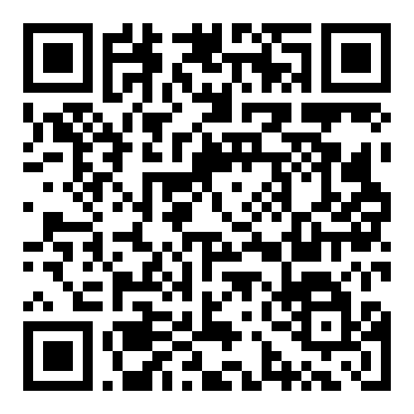
Want to join us at our Thrive Summit?
Join us at the Thrive Summit on Friday 16th October 2026, The Studio, Leeds for a refreshing, human-centred take on the legal and people challenges shaping the future of work. This isn't a day of legal jargon and theory. It's a day of practical insight, honest conversations, and actionable strategies that will help you build a workplace where people and performance can thrive.
Why attend?
Because compliance is only part of the picture.
The organisations that will succeed in the future are those that understand the intersection between law, people, inclusion and culture. This event will give you the confidence, clarity and practical tools to navigate change, support your people and make better strategic decisions.
Join us for a day of learning, connection and forward-thinking conversations.
Leave inspired. Leave informed. Leave with a plan.
Join here today!
thrivelaw.co.uk | enquiries@thrivelaw.co.uk | 0113 869 8101
Notes:
Bryony

Slide 21
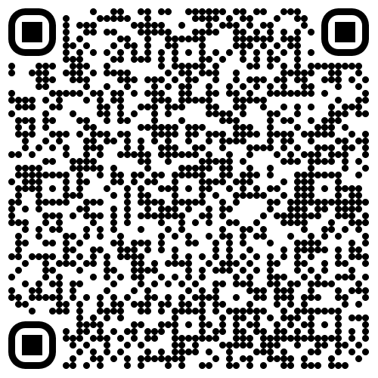
Next Webinar
Want to keep the conversation going?
Join us next time for our Learn & Lunch Webinar!
Register here to join us!
Date: 07 October 2026
Next in the Learn and Lunch series: Women’s Health at Work
An employment law update regarding women’s health at work and what to expect and plan for with the new employment rights act.
thrivelaw.co.uk | enquiries@thrivelaw.co.uk | 0113 869 8101
Notes:
Ashmina
Before you go, a quick word about what is next.
Our next session is on 7 October 2026, it will focus on Women's Health at Work!
Please do sign up and share it with colleagues who would find it useful. These sessions are shaped by what you tell us you want to know, so if there is a topic you would like us to cover, put it in the chat or email us.

Slide 22















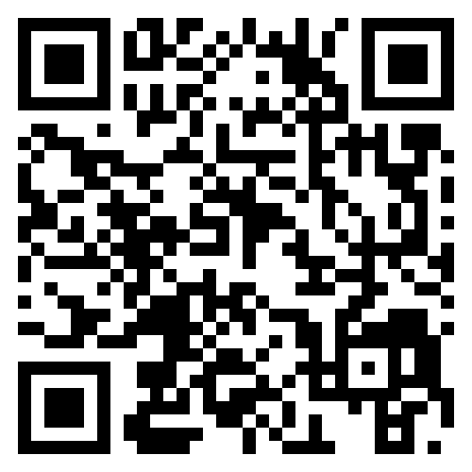
Thank You
Stay connected with us on socials
Facebook: thrivelawleeds
Twitter: @thrive_law and @iamjodiehill
Instagram: thrive_law and iamjodiehill
LinkedIn: thrive-lawleeds and jodie-hill-lawyer
Scan the QR code and tell us what you thought about this webinar
Notes:
Ashmina
Thank you all for joining us today, and thank you for the questions.
Please do scan the QR code and let us know what you thought. We read every response and it genuinely shapes what we run next.
Stay connected with us on our socials, the handles are on screen. And if today has raised something you want to talk through, our contact details are on the next slide.

Slide 23

Disclaimer
Please note that the information contained in this presentation is provided for general informational purposes only. It does not constitute any form of legal or other professional advice, and you should not use it as a substitute for advice tailored to your specific circumstances.
We disclaim all and any liability for any actions you take (or omit to take) in reliance upon the contents of this presentation.
Our contact details are below should you wish to contact us for professional advice.
Jodie Hill, Jodie.hill@thrivelaw.co.uk
enquiries@thrivelaw.co.uk 0113 869 8101
Thrive Law Leeds
Bank House, 27 King Street, Leeds, LS1 2HL
Thrive Law London
85 Great Portland Street, 1st Floor, London, W1W 7LT

